Slide 1
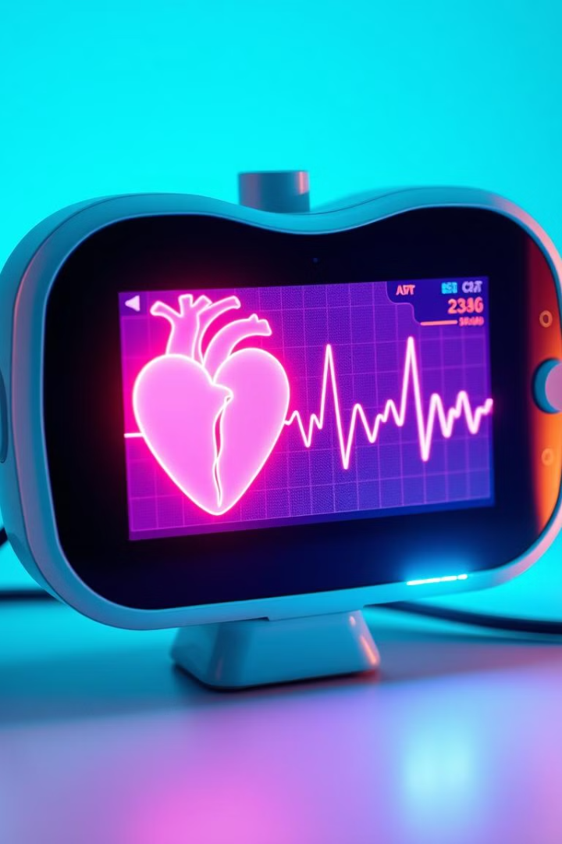
Heart Guard: Revolutionizing Cardiac Care
Presented by: Youssef Khalid, Mohamed Ahmed, Mohamed Hisham, Omar Galal, Ahmed Fouad
Supervised by: Dr. Nermin Naguib, Eng. Merna Esam

Slide 2
Heart Guard: Table of Contents
1
Introduction
2
Motivation
3
Problem Statement
4
Similar Systems
5
System Overview
6
Deliverables
7
Timeline
8
Supportive Documents
9
Demo

Slide 3
Introduction
Transforming Healthcare
Cardiovascular Disease
Accessibility Gap
Early detection often requires specialized resources, creating a gap in access for many.
Advancements in medical technology are improving accessibility and patient outcomes.
A leading cause of death worldwide, highlighting the critical need for improved preventative care.

Slide 4

Motivation
Academic
Business
Global Impact
Early diagnosis is crucial, but access to reliable tools is limited.
The mHealth industry is growing rapidly, presenting a significant opportunity for impact.
The World Health Organization estimates 17.9 million deaths annually from cardiovascular disease.

Slide 5
Problem Statement
Late Diagnosis
Auscultation Challenges
Limited Accessibility
Cardiovascular diseases are a leading cause of death due to delayed or missed diagnoses.
Current diagnostic tools are expensive and not readily available in many settings.
Traditional auscultation requires training and experience, making it challenging for non-specialists.

Slide 6
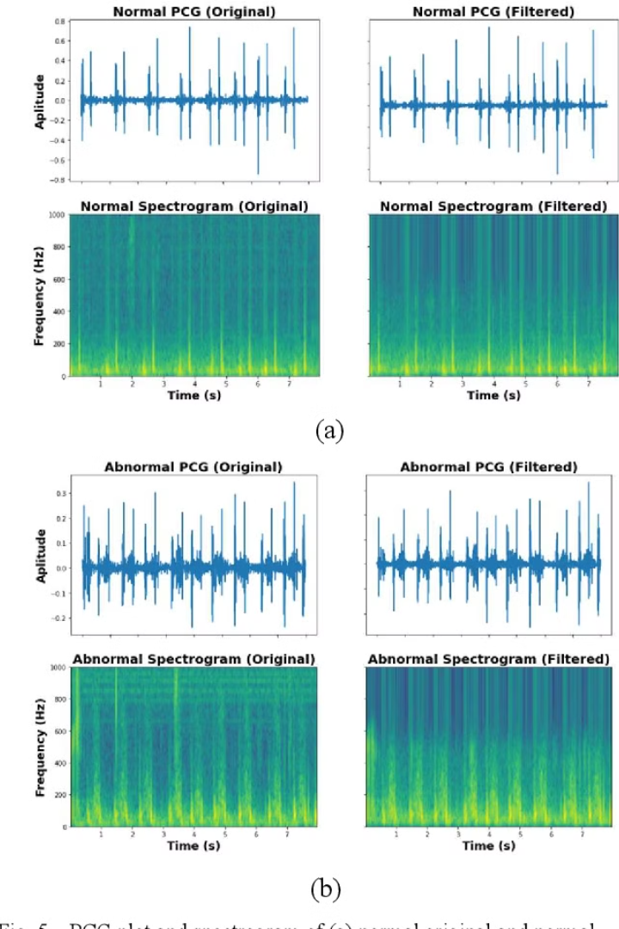



Similar Systems
Heart Sound Classification
Introduces a heartwave dataset but lacks detailed performance metrics.
HeartWave Dataset
Provides a high-quality dataset, but lacks detailed performance metrics of trained models.
Heart Sound Detection
Uses an electronic stethoscope with MATLAB, limiting accessibility due to custom hardware.

Slide 7
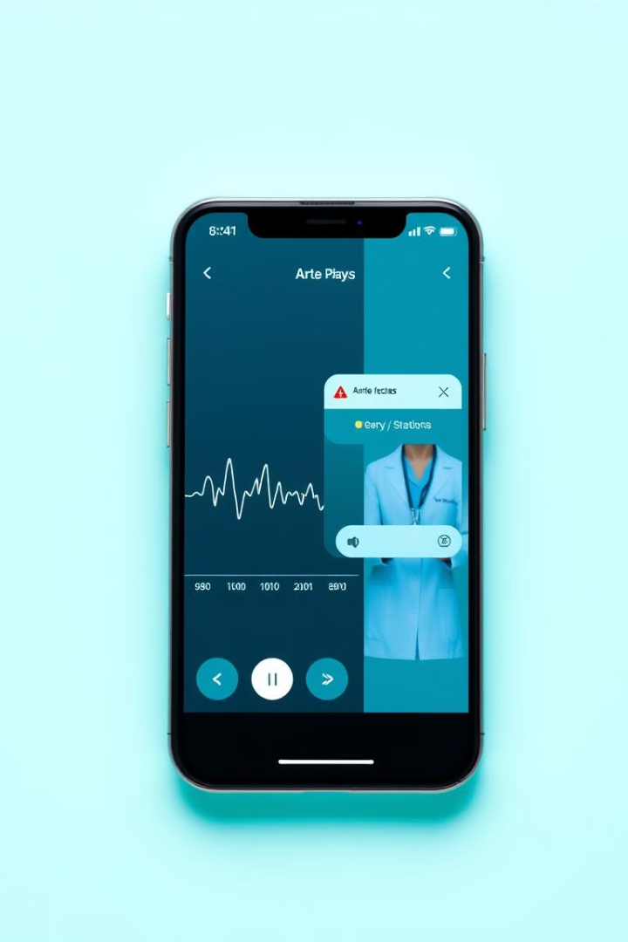
System Overview
1
Heart Sound Recording
Mobile application for easy heart sound recording.
2
Cloud Storage and Analysis
Machine learning analysis on secure cloud storage.
3
Emergency Notification
Real-time alerts to healthcare providers or emergency contacts.
4
User Profiles and Monitoring
User profiles with emergency contacts and wearable device compatibility.

Slide 8
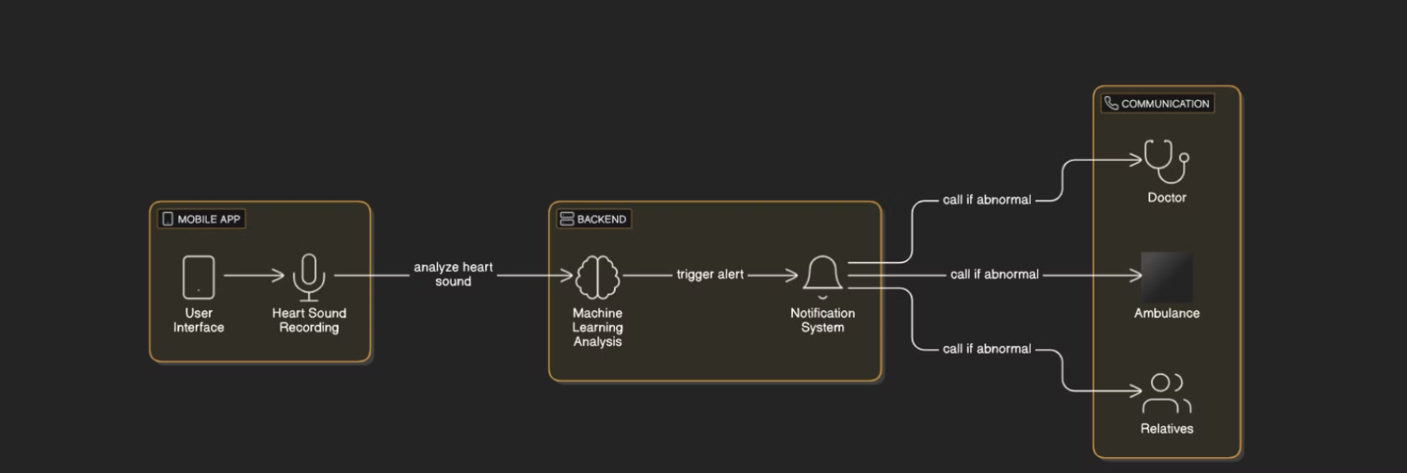
System Overview

Slide 9

Deliverables
1
Mobile Application
2
Project Reports
3
Presentation
A fully functional app for heart sound recording, analysis, and notification.
Detailed documentation covering system design, implementation, and testing.
A final presentation summarizing project outcomes and results.

Slide 10



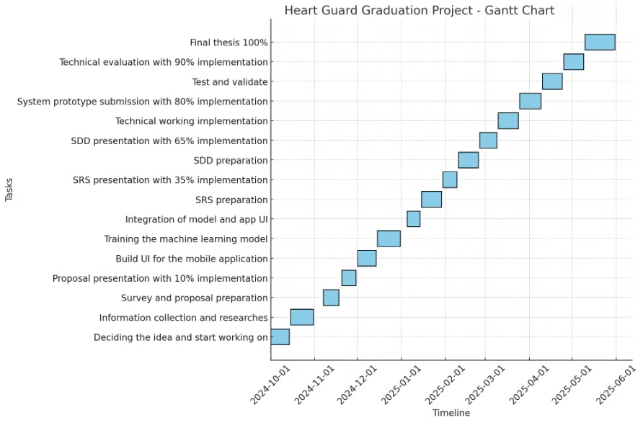



Timeline
Project Kickoff
Initial planning and requirements gathering.
App Development
Design, coding, and testing of the mobile application.
Machine Learning Integration
Training and integration of machine learning models.
Testing and Refinement
Thorough testing and user feedback incorporation.
Finalization and Deployment
Polishing the application and preparing for launch.

Slide 11
Supportive Documents
Dataset
Surveys
Related Companies
PhysioNet/CinC Challenge 2016 heart sound dataset for model training and validation.
Surveys conducted with potential users to gather valuable feedback and insights.
Companies developing similar heart health monitoring solutions for comparative analysis.

Slide 12
Heart Guard: System Overview & Demo
Existing System
Demo
Mobile application for heart sound recording, cloud storage and analysis, emergency notification, and user profiles with monitoring.
Interactive demonstration showcasing the real-time heart sound analysis, personalized risk assessment, and user-friendly interface of the Heart Guard application.

Slide 13
Thanks for investing your valuable time with us.

